Slide 1
Employee Data Analysis using Excel
Name :DHANALAKSHMI.K
Register No : 312214998
Department : COMMERCE
College : SOKA IKEDA COLLEGE

Slide 2
PROJECT TITLE
EMPLOYEE PERFORMANCE ANALYSIS USING EXCEL

Slide 3
AGENDA
1.Problem statement
2.Project Overview
3.End users
4.Our solution and proposition
5.Dataset description
6.Modeling approach
7.Results and discussion
8.Conclusion

Slide 4
Problem statement
01
How can we develop an effective training program to Hannan employee skills and knowledge leading to better job performance ?
How can we optimise our performance management system to provide constructive feedback set clear goal and evaluate employee performance fairly ?
02
What are the barriers to affect the communication and collaboration amount teens and the how can we overcome them to heavens employee performance ?
03

Slide 5
Project overview
Employee analysis is the process of evaluating an employee's performance, skills, and contributions to the organization.
Objective:To analyze and evaluate employee performance, identify areas of strength and improvement, and provide insights for informed decision-making.

Slide 6



Who are the end users ?
Employee

Slide 7
Our solution and and its value proposition
=IFS(Z2>=5,"VERY HIGH",Z2>=4,"HIGH",Z2>=3,"MED",TRUE,"LOW") - to calculate employee performance
PIVOT TABLE - summary
GRAPH - data visuvalization

Slide 8
Dataset description
Employee dataset = Kaggle.com
Employee ID- Numericals
Name - Text form
Business Unit
Gender Code
Performance Score
Current Employee Rating
performance category

Slide 9
The “WOW” in your solution
Performance category
=IFS(Z2>=5,"VERY HIGH",Z2>=4,"HIGH",Z2>=3,"MED",TRUE,"LOW")

Slide 10
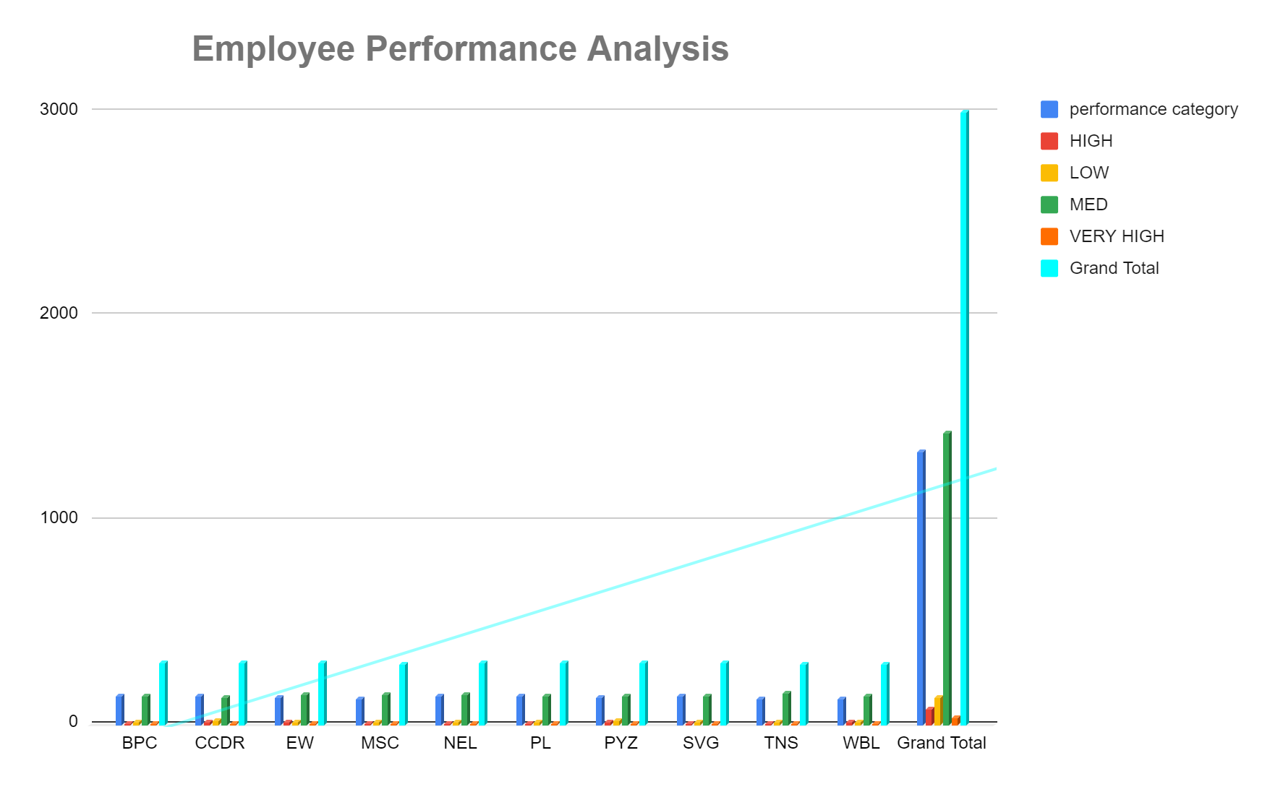
Result

Slide 11
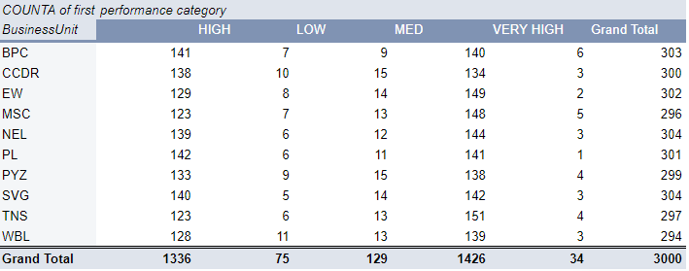

Slide 12
Conclusion
With targeted encouragement and motivation, medium-level performing employees can be developed into high-performing employees, leading to a gradual increase in overall performance trends. By recognizing and building on their strengths, providing tailored support and resources, and fostering a growth-oriented culture, organizations can unlock the full potential of their workforce and drive sustained improvement in performance outcomes.

Slide 13


